Slide 1
Philippians 1:12-27 (NIV)
12Now I want you to know, brothers, that what has happened to me has really served to advance the gospel. 13As a result, it has become clear throughout the whole palace guard and to everyone else that I am in chains for Christ. 14Because of my chains, most of the brothers in the Lord have been encouraged to speak the word of God more courageously and fearlessly. 15It is true that some preach Christ out of envy and rivalry, but others out of goodwill. 16The latter do so in love, knowing that I am put here for the defense of the gospel.

Slide 2
Philippians 1:12-27 (NIV)
17The former preach Christ out of selfish ambition, not sincerely, supposing that they can stir up trouble for me while I am in chains. 18But what does it matter? The important thing is that in every way, whether from false motives or true, Christ is preached. And because of this I rejoice. 19Yes, and I will continue to rejoice, for I know that through your prayers and the help given by the Spirit of Jesus Christ, what has happened to me will turn out for my deliverance.

Slide 3
Philippians 1:12-27 (NIV)
20I eagerly expect and hope that I will in no way be ashamed, but will have sufficient courage so that now as always Christ will be exalted in my body, whether by life or by death. 21For to me, to live is Christ and to die is gain. 22If I am to go on living in the body, this will mean fruitful labor for me. Yet what shall I choose? I do not know! 23I am torn between the two: I desire to depart and be with Christ, which is better by far; 24but it is more necessary for you that I remain in the body.

Slide 4
Philippians 1:12-27 (NIV)
25Convinced of this, I know that I will remain, and I will continue with all of you for your progress and joy in the faith, 26so that through my being with you again your joy in Christ Jesus will overflow on account of me. 27Whatever happens, conduct yourselves in a manner worthy of the gospel of Christ.

Slide 5
Peter Keep – 10/07/2022

Slide 6
Paul and the Philippians’ mature faith
are examples to learn from.
Paul desired their maturity
began a good work in you will carry it on to completion [1:6]
able to discern what is best and may be pure & blameless [1:10]
conduct yourselves in a manner worthy of the gospel [1:27]
continue to work out your salvation with fear and trembling [2:12]
so that you may become blameless and pure [2:14-15]
let us live up to what we have already attained. [3:16]
MARKS OF MATURITY

Slide 7
* Christian a long time * Big Bible knowledge * Served a lot
X
Putting into practice what we know

Slide 9
KEEPING THE FAITH WHEN THINGS GET TOUGH
Part of human living
[JOHN 16:33]
FACING TROUBLES

Slide 10
KEEPING THE FAITH WHEN THINGS GET TOUGH
TWO TYPES OF TROUBLE
X
INVITED
[that which we bring on ourselves]
UNINVITED
[surprisingly comes our way]

Slide 11
KEEPING THE FAITH WHEN THINGS GET TOUGH
… in prison more …flogged … life threatened repeatedly… thirty-nine lashes five times … beaten three times … pelted with stones once … ship- wrecked … spent a night and day in the sea … always on the move … in danger from: rivers, bandits, fellow Jews, Gentiles; in danger: in the city, in the country, at sea; in danger from false believers … often sleep deprived… thirsty … often went without food; been cold and naked …faced the daily pressure of his concern for all the churches. [2 COR. 11:23-28]
PAUL FAMILIAR WITH
TROUBLES

Slide 12
KEEPING THE FAITH WHEN THINGS GET TOUGH
We were under great pressure, far beyond our ability to endure, so that we despaired of life itself. ⁹Indeed, we felt we had received the sentence of death. But this happened that we might not rely on ourselves but on God, who raises the dead.
[1 CORINTHIANS 1:8-9]
PAUL FAMILIAR WITH
TROUBLES

Slide 13
Learn about dealing with troubles from Paul’s example in the letter to the Philippians

Slide 14
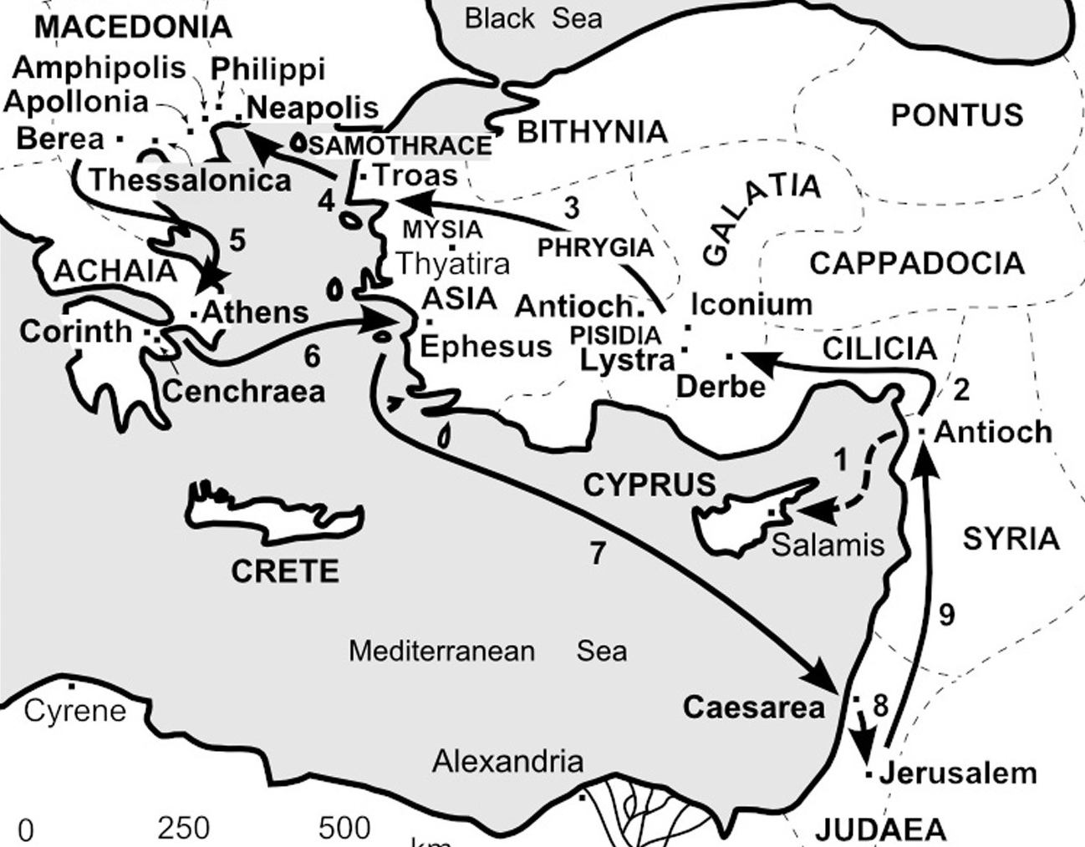
FULFILLMENT ACTS 16-18
VISION ACTS 16:9-10
Paul’s Second Missionary Journey

Slide 15
PAUL’S TROUBLES
PAUL’S RESPONSE
IMPRISONED [1:7 & 14]
ENEMIES [1:15-17]
UNCERTAINTY [1:19-26]
SPENT [2:17]
LACK [4:2-14]

Slide 16
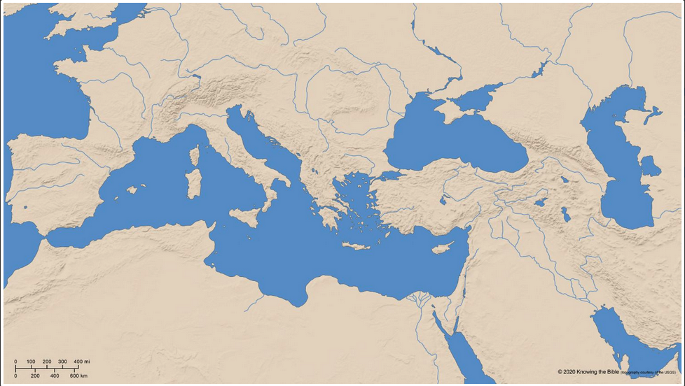
IMPRISONMENT: Ephesus, Caesarea Maritima or Rome
ROME
ACTS 29:11-31
EPHESUS
ACTS 19
2-3 years
CAESAREA (MARITIMA)
ACTS 23:24-26:32

Slide 17
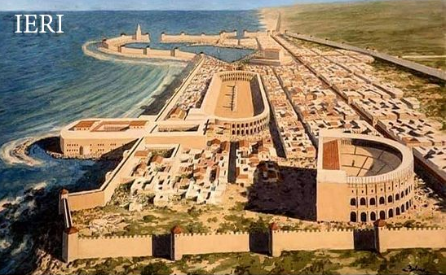
IMPRISONMENT
Ephesus
Rome
Caesarea Maritima
CAESAREA MARITIMA RECONSTRUCTION
PAUL’S RESPONSE
IMPRISONED [1:7 & 14]
ENEMIES [1:15-17]
UNCERTAINTY [1:19-26]
SPENT [2:17]
LACK [4:2-14]
https://i.redd.it/dsyr567vli291.jpg

Slide 18
PAUL’S TROUBLES
PAUL’S RESPONSE
IMPRISONED [1:7 & 14] | Looked for what God was doing
ENEMIES [1:15-17]
UNCERTAINTY [1:19-26]
SPENT [2:17]
LACK [4:2-14]

Slide 19
PAUL’S TROUBLES
PAUL’S RESPONSE
IMPRISONED [1:7 & 14] | Looked for what God was doing
ENEMIES [1:15-17] | Relinquished personal ambition
UNCERTAINTY [1:19-26]
SPENT [2:17]
LACK [4:2-14]

Slide 20
PAUL’S TROUBLES
PAUL’S RESPONSE
IMPRISONED [1:7 & 14] | Looked for what God was doing
ENEMIES [1:15-17] | Relinquished personal ambition
UNCERTAINTY [1:19-26] | Aimed to please God, whatever
SPENT [2:17]
LACK [4:2-14]

Slide 21
PAUL’S TROUBLES
PAUL’S RESPONSE
IMPRISONED [1:7 & 14] | Looked for what God was doing
ENEMIES [1:15-17] | Relinquished personal ambition
UNCERTAINTY [1:19-26] | Aimed to please God, whatever
SPENT [2:17] | Rejoiced at giving himself
LACK [4:2-14]

Slide 22
PAUL’S TROUBLES
PAUL’S RESPONSE
IMPRISONED [1:7 & 14] | Looked for what God was doing
ENEMIES [1:15-17] | Relinquished personal ambition
UNCERTAINTY [1:19-26] | Aimed to please God, whatever
SPENT [2:17] | Rejoiced at giving himself
LACK [4:2-14] | Found contentment in Christ

Slide 23
OUR RESPONSE
 | Try to find what God is doing
 | Don’t worry about others view
 | Aim to please God, whatever
 | Rejoice, despite circumstances
 | Find your safe place in trusting God
OUR
TROUBLES
if any of you lacks wisdom, you should ask God, who gives generously to all without finding fault, and it will be given to you. [JAMES 1:5]

Slide 24
OUR RESPONSE
 | Try to find what God is doing
 | Don’t worry about reputation
 | Aim to please God, whatever
 | Rejoice, despite circumstances
 | Find your safe place in trusting God
OUR
TROUBLES

Slide 25
OUR RESPONSE
 | Try to find what God is doing
 | Don’t worry about reputation
 | Keep pressing on with pleasing God
 | Rejoice, despite circumstances
 | Find your safe place in trusting God
OUR
TROUBLES

Slide 26
OUR RESPONSE
 | Try to find what God is doing
 | Don’t worry about reputation
 | Keep pressing on with pleasing God
 | Rejoice, despite circumstances
 | Find your safe place in trusting God
OUR
TROUBLES
give thanks in all circumstances; for this is God’s will for you in Christ Jesus. [1 THESS. 5:18]

Slide 27
OUR RESPONSE
 | Try to find what God is doing
 | Don’t worry about reputation
 | Keep pressing on with pleasing God
 | Rejoice, despite circumstances
 | Find your safe place in trusting God
OUR
TROUBLES

Slide 28
TROUBLES ARE NORMAL
LIVE UNDER THEIR CONTROL
LIVE WITH THEM IN FAITH
CHOOSE

